Slide 1
PULMONARY FUNCTION TEST AND SPIROMETER
By Eyayalem M. (Assistant. Professor;March, 2025)

Slide 2
PULMONARY FUNCTION TEST AND SPIROMETER
Spirometry
is the most common type of pulmonary function or breathing test.
has proved to be an effective, inexpensive, and noninvasive way of measuring pulmonary reserve and predicting postoperative pulmonary function.
assesses the integrated mechanical function of the lung, chest wall, respiratory muscles, and airways by measuring the total volume of air exhaled from a full lung (total lung capacity [TLC]) to maximal expiration (residual volume [RV]).

Slide 3
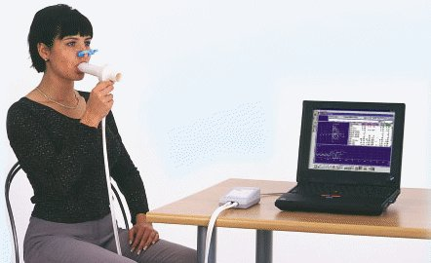
Spirometer

Slide 4
PULMONARY FUNCTION TEST &…
Pulmonary function tests are done to:
Help in the diagnosis of certain types of lung disease, such as asthma, bronchitis, and emphysema.
Find the cause of shortness of breath.
Measure whether exposure to chemicals at work affects lung function.
Check lung function before someone has surgery
Assess the effect of medicines
Measure progress in disease treatment
Measure the response to treatment in cardiopulmonary vascular disease

Slide 5
Two important parameters
FVC - Forced Vital Capacity. This is the total amount of air that you blow out in one breath.
FEV1 - Forced Expiratory Volume in one Second. This is the amount of air you can blow out within one second. With normal lungs and airways you can normally blow out most of the air from your lungs within one second.

Slide 6
Spirometry: Normal and COPD

Slide 7
Spirometry
Forced vital capacity (FVC), forced expired volume in 1st second (FEV₁), and peak expiratory flow can be measured at the patient’s bed side using a spirometer.
A vital capacity of at least three times the VT is necessary for an effective cough.
A vital capacity of less than 50 % of predicted or less than 2 lit is an indicator of increased risk.

Slide 8
FVC
Interpretation of % predicted:
80-120% Normal
70-79% Mild reduction
50%-69% Moderate reduction
<50% Severe reduction
VC(ml)= (27.63-o.112*age)Ht cm in Male
VC(ml)= (21.78-0.101*age) Ht cm in female

Slide 9
Spirometry
FVC - is used to diagnose restrictive ventilatory impairment.
A patient with an abnormal vital capacity has a 33 % chance of complications and a10 % risk of post operative mortality.
FEV₁, is more direct indication of airway obstruction.

Slide 10
Spirometry
In the past, an FEV₁ of <800 ml in a 70-kg man had been considered an absolute contraindication to lung resection.
1
However some procedures have done successfully in patients with smaller lung volumes.
2
It is preferable to indicate the percentage of predicted value, rather than just using the actual results in liters.
3

Slide 11
Spirometry….
The ratio FEV1/FVC is useful in differentiating b/n restrictive & obstructive .
It’s normal ratio value is > 0.75(75%) .
It is normal in restrictive disease, because both decreases
In obstructive disease, the ratio is generally low, because FEV₁ is markedly decreased.
Mortality in patients with FEV₁ greater than 2 lit. is 10 % and in patients below 1 lit is between 20 % - 45 %.

Slide 12
Spirometry….
In obstructive disease, the ratio is generally low, because FEV₁ is markedly decreased.
A ratio of Residual Volume to total lung capacity (RV/TLC) of greater than 50 % is generally indicative of a high risk patient for pulmonary resection

Slide 13
FEV1/FVC ratio
Reduced in obstructive disorders.
Interpretation of % predicted:
- >75% Normal
- 60%‐75% Mild obstruction
- 50‐59% Moderate obstruction
- <49% Severe obstruction
It is normal in restrictive disease

Slide 14
Spirometry…
The maximal voluntary ventilation (MVV)
Is the largest amount of air that a person can inhale and then exhale during a 12- to 15-s interval with maximal voluntary effort (Neder et al., 1999)
Maximum voluntary ventilation(MVV) <50% is high risk.
But MVV is not systematically evaluated as a predictor of morbidity

Slide 15
Significance of Bronchodilator therapy
Pulmonary function tests are usually performed before and after bronchodilator
therapy to assess the reversibility of the airways obstruction.
A 15 % improvement in pulmonary function tests may be considered a positive response to bronchodilator therapy and indicates that this therapy should be initiated preoperatively.

Slide 16
Effects of Anesthesia and Surgery on Lung Volumes
- Anesthesia and postoperative medications can cause changes in lung volumes and ventilatory pattern.
Total lung capacity → decreases after abdominal surgery but not after surgery on an extremity.
Vital capacity → decreased by 25 - 50 % within 1-2 days after surgery and generally returns to normal after 1-2 weeks.

Slide 17
Effects of Anesthesia and Surgery on Lung Volumes
- Residual volume - increases by 13% where as expiratory reserve volume decreased by 25 % after lower abdominal surgery and 60% after upper abdominal and thoracic surgery.
Tidal volume (VT) - decreases by 20% within 24 hrs. After surgery and gradually returns to normal after 2 weeks.
Pulmonary compliance - decreases by 33% with similar reductions in functional residual capacity (FRC) secondary to small airways closure.

Slide 18
Split Lung Function and Ventilation Perfusion Studies
This nuclear medicine procedure is done to evaluate respectability of lung tissue on patients with lung carcinoma or lung transplant.
The concern relates to whether there is enough viable lung tissue following the removal of cancerous lung tissue.
The rationale to perform the thoracotomy is based on:
Resecting the tumor
Patient's ability to tolerate the surgical results

Slide 19
Split Lung Function and Ventilation Perfusion Studies
The involved lung tissue may contribute little to existing lung function, and therefore its removal may not cause further deterioration of pulmonary function.
Thus some patients who would be denied operations based on the initial results may be considered surgical candidates after more specific evaluation.

Slide 20
Split-lung Function Tests
Regional lung function studies serve to predict the function of the lung tissue that would remain after lung resection.
methods have been described to try and simulate the postoperative respiratory situation by unilateral exclusion of a lung or lobe with an endobronchial tube/blocker or by pulmonary artery balloon occlusion of a lung or lobe artery
A whole (two)-lung test may fail to estimate whether the amount of post resection lung tissue will allow the patient to function at a reasonable level of activity without disabling dyspnea or cor pulmonale

Slide 21
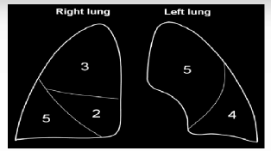
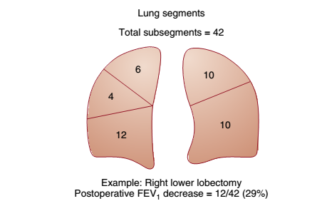
Lug ,Lobes,Segments and Sub segments
Lung Segments
Lung Sub segments

Slide 22
Risk stratification
The best assessment of respiratory function comes from a history of the patient's quality of life.
An asymptomatic American Society of Anesthesiologists (ASA) class I or II patient with full exercise capacity does not need screening cardiorespiratory testing.

Slide 23
Risk stratification
Assess respiratory function in three related but independent areas:
Respiratory Mechanics
Gas Exchange, And
Cardiopulmonary Interaction.
These three factors give the "three-legged stool" of prethoracotomy respiratory assessment.

Slide 24
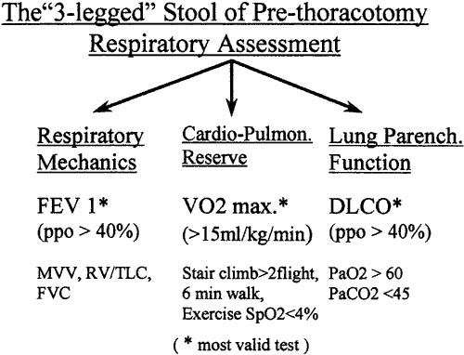

Slide 25
Risk stratification
Lung mechanics.
- Respiratory mechanics are assessed by pulmonary function tests.
Of these parameters, the most useful is the predicted postoperative forced expiratory volume in one sec (FEV 1 ), which is calculated as follows:
Postoperative FEV 1 = preoperative FEV 1 × (1 – the percentage
of functional lung tissue removed divided by
100) OR---
-- Postoperative FEV 1 = preoperative FEV 1 X No of Segments left after Resection
19

Slide 26

Risk stratification
Mortality and morbidity are significantly increased if postoperative FEV 1 is less than 40% of normative FEV 1 , and patients with predicted postoperative FEV 1 of less than 30% may need postoperative mechanical ventilatory support

Slide 27
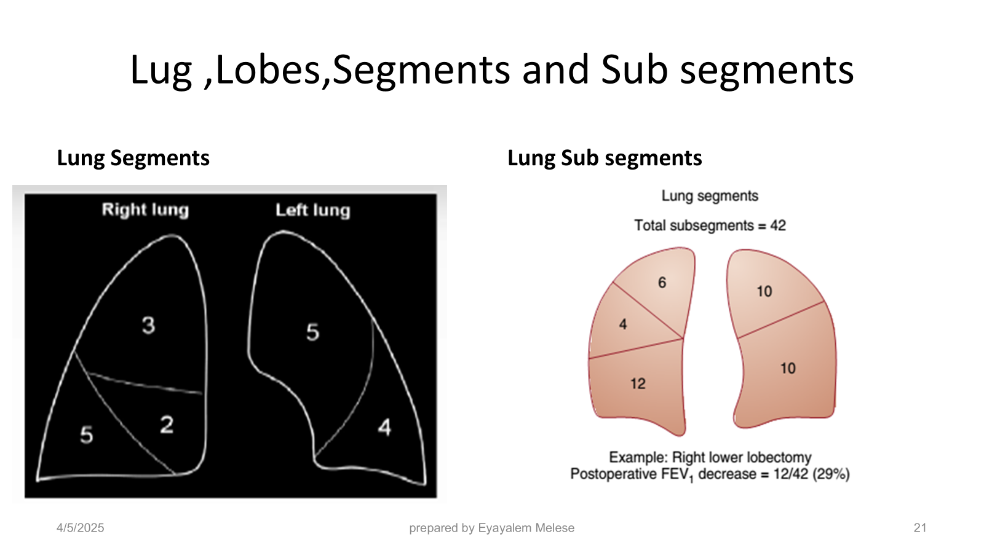
A 57 -year- old man is booked for Lung rescetion.His CT chest shows a large RUL mass confirmed as carcinoma. Preoperative FEV1 was 50,Calculate the predicted Post operative FEV-1. Is this patient Fit for thoracic Anesthesia?

Slide 28
Risk stratification
2. Pulmonary parenchymal.
The most useful test of the gas exchange capacity of the lung is the diffusing capacity for carbon monoxide (DLCO).
DLCO correlates with the total functioning surface area of alveolar–capillary interface. A ppoDLCO less than 40% correlates with both increased respiratory and cardiac complications.

Slide 29
FACTORS AFFECTING DLCO
Notes:
Predicted DLCO for Hb= Predicted DLCO * (1.7 Hb/10.22 + Hb)

Slide 30
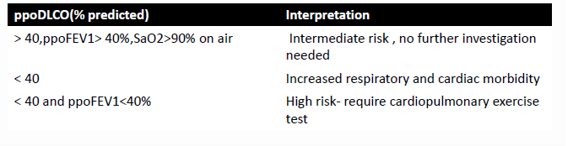
Pulmonary parenchymal

Slide 31
Risk stratification
Cardiopulmonary interaction.
The traditional, and still extremely useful, test in ambulatory patients is stair climbing. The ability to climb three flights or more is closely associated with decreased mortality.
Less than two flights is very high risk. Formal laboratory exercise testing is currently the "gold standard" for assessment of cardiopulmonary function.

Slide 32
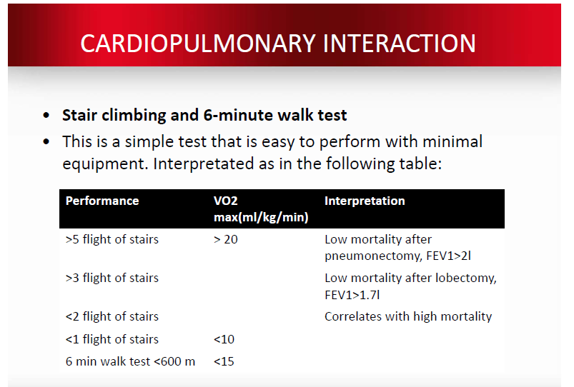

Slide 33
Risk stratification
The maximal oxygen consumption Vo₂max is the most valid exercise predictor of post thoracotomy outcome.
Low risk = Vo₂max > 20 mL/kg/min
Moderate risk = Vo₂max 15 to 20 mL/kg/min
High risk = Vo₂max < 15 mL/kg/min
The 6-minute walk test and exercise oximetry also correlate
with Vo₂max.
Vo₂max =15 x HR maximum /Resting HR
Vo₂max = 6-minute walk test distance in meters / 30

Slide 34
Combination of tests
If a patient has ppoFEV₁ greater than 40%, it should be possible for the patient to be extubated in the operating room at the conclusion of surgery, assuming the patient is alert, warm, and comfortable ("AWaC").
If ppoFEV₁ is greater than 30% and exercise tolerance and lung parenchymal function exceed the increased risk thresholds, then extubation in the operating room should be possible depending on the status of associated diseases.

Slide 35
Combination of tests
Patients with ppoFEV₁ 20% to 30% and favorable predicted cardiorespiratory and parenchymal function can be considered for early extubation if thoracic epidural analgesia is used

Slide 36
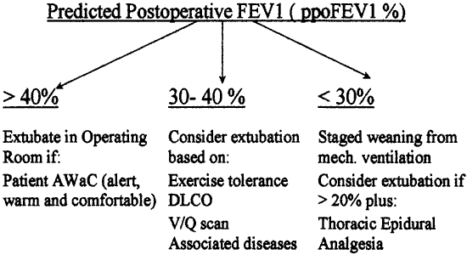

Slide 37
GAS EXCHANGE TEST

Slide 38
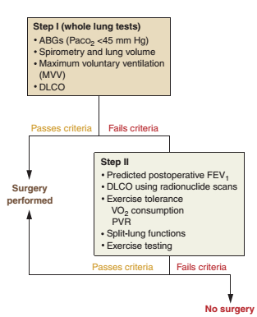
Sequence of testing Lung Rescetion

Slide 39
Thanks!!
Stay Safe!

